Slide 1

Upload of MEDITS data
2nd Training
Excelsior Hotel, Bari (Italy), 20th-24th January 2025
W. Zupa, I. Bitetto

Slide 2
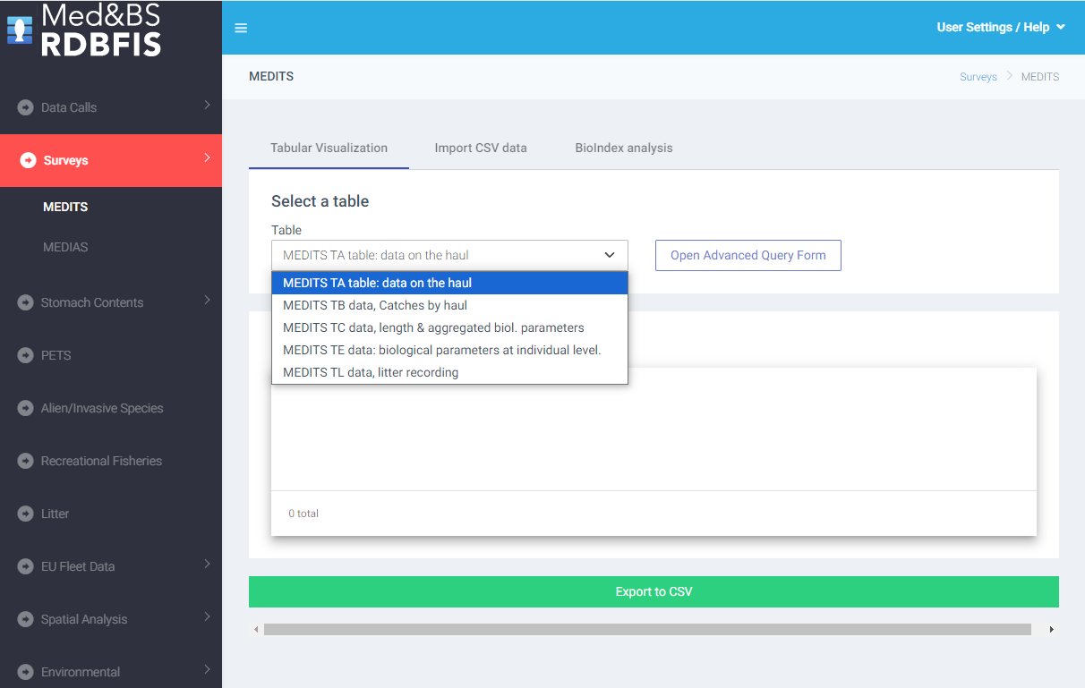

Slide 3
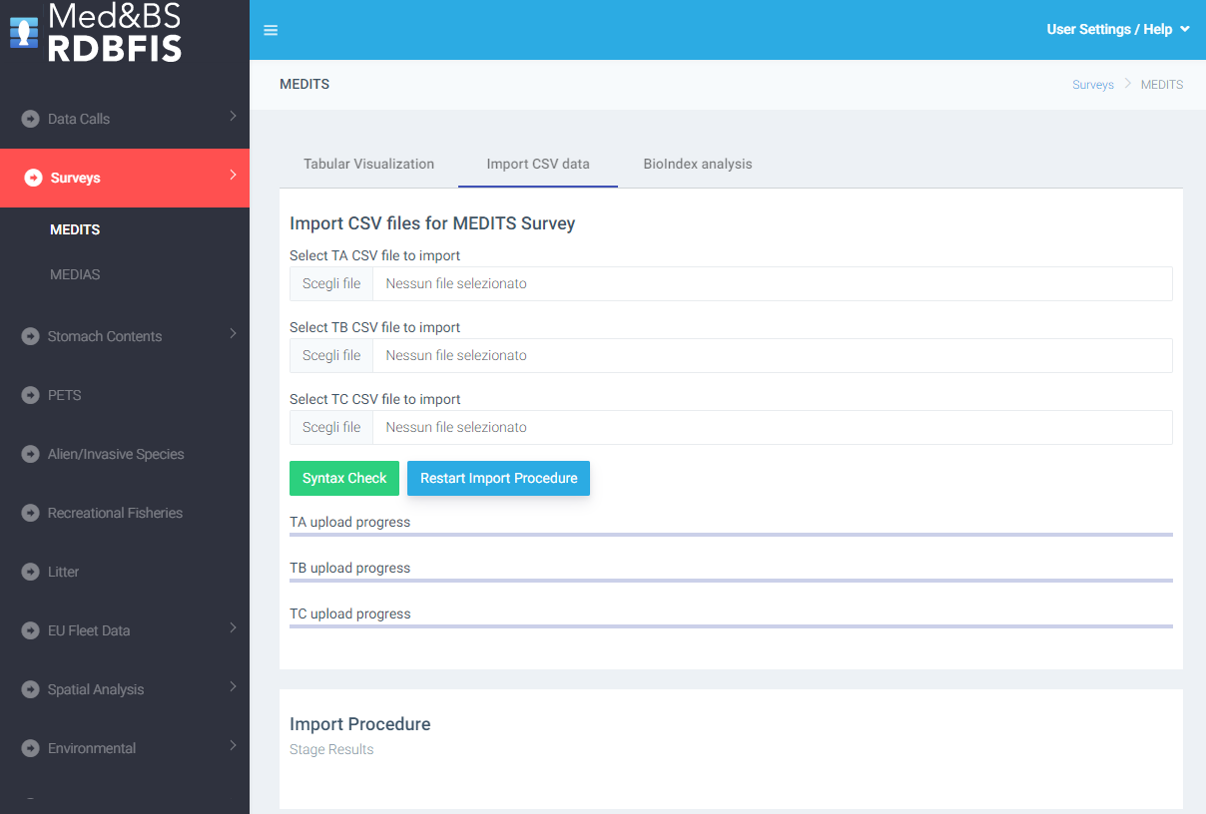

Slide 4
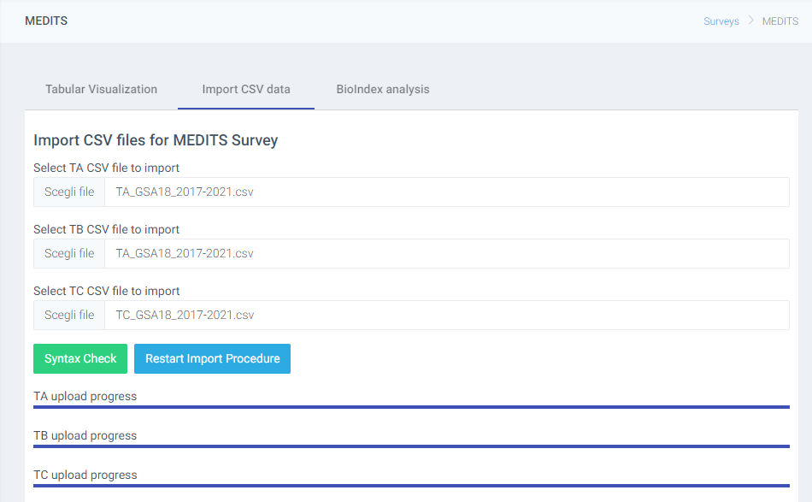
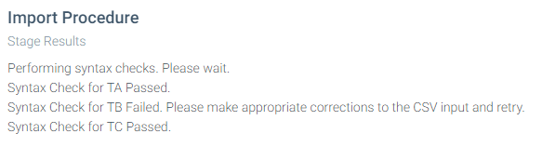
Data table not consistent with expected data

Slide 5
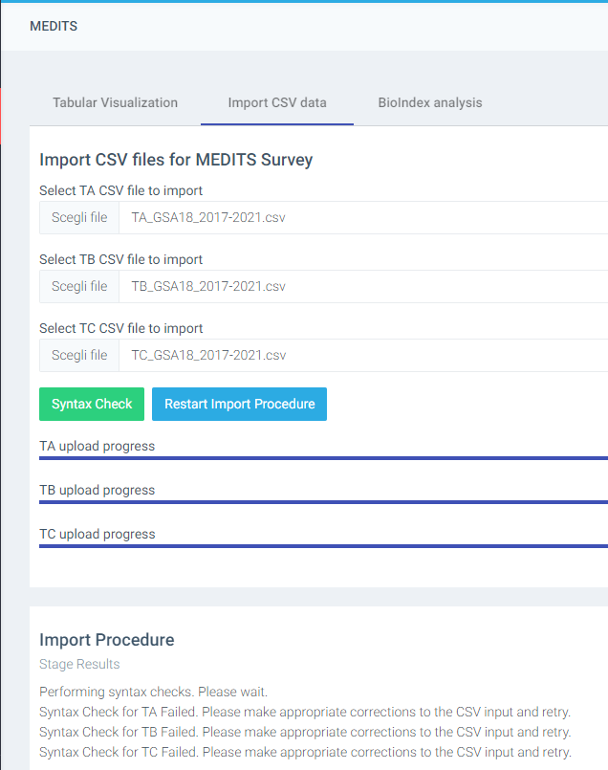
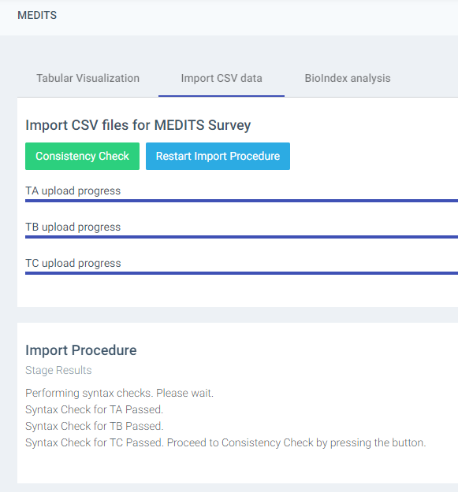
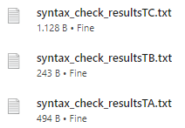

Slide 6
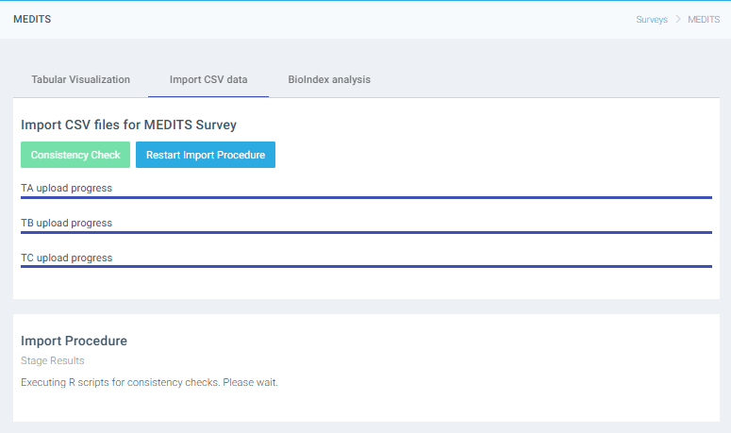


Slide 7
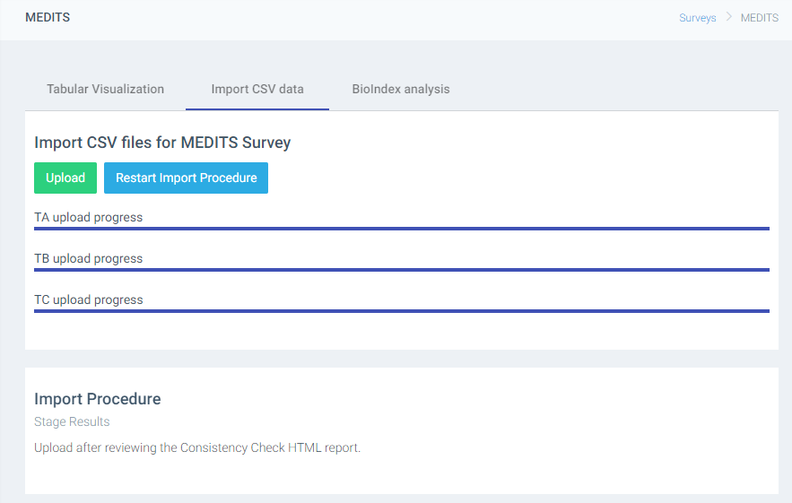
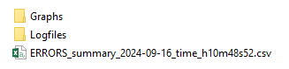
the outputs of the analysis are saved in a zip file containing all the results

Slide 8

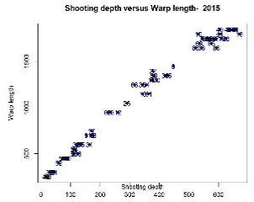
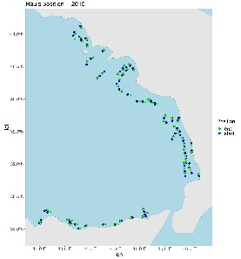
Mean features
Input: Exchange data tables in .csv format (TA, TB and TC, TE, TL) and additional tables from MEDITS manual (TM list, maturity scales table, stratification, etc..)
Output: Report of errors, Text file (Logfile.dat) with the outcome of each check and errors/warnings specifications and plots for qualitative controls.
Inputs
Outputs
haul____
catch ____
Sequence of the function calls in RoME
Check duplicated records on TX files
Check quasi-identical records on TX files
Check AREA and YEAR fields are the same for all the files
Check dictionary on TX files
Specific checks on TA
Specific checks on TB
Specific checks on TC
Specific checks on TE
Specific checks on TL
Cross checks
biological ____
Logfile
____
species
____
maturity
____
strata
___
RoME detects errors, then is up to the final user to correct them
size
___
Supplementary tables

Slide 9

##################################################################
# RoME v.0.1.38 R Code to Perform Multiple Checks on MEDITS Survey Data
# W. Zupa, I. Bitetto, M.T. Spedicato
#
# In case of use of the software, the Authors should be cited.
# If you have any comments or suggestions please contact the following
# e-mail address: zupa@coispa.it
#
# This program is free software; you can redistribute it and/or
# modify it under the terms of the GNU General Public License
# as published by the Free Software Foundation; either version 2
# of the License, or (at your option) any later version.
#
# This program is distributed in the hope that it will be useful,
# but WITHOUT ANY WARRANTY; without even the implied warranty of
# MERCHANTABILITY or FITNESS FOR A PARTICULAR PURPOSE. See the
# GNU General Public License for more details.
##################################################################
Version 0.1.38
NEW FEATURES
Completely updated version, compatible with the more recent versions of R software and dependencies
Multiplatform (Windows and Linux for RDBFIS)
67 standalone check functions
Documentation embedded in the package
Runs embedded in RDBFIS and stand-alone
Improved quality of plots and maps;
Specific functions for RDBFIS
RoMEcc (and RoMEBScc) to analyse the MEDITS tables without interruption and report all the errors occurred (error report + logfile)
all the outputs of the analysis are also stored in a local zip file
Environment
R version > 4.1.2
Rstudio: v. 2022.12.0
License: GPL-3

Slide 10
Report of the errors
errors | check type | table | variable | year
 | Check Headers | TA | NA | NA
 | Check Headers | TB | NA | NA
 | Check Headers | TC | NA | NA
 | Check CLASS | TA | NA | NA
 | Check CLASS | TB | NA | NA
 | Check CLASS | TC | NA | NA
 | Check YEAR | ALL | NA | NA
 | Check TYPE_OF_FILE | ALL | NA | NA
 | Check identical record TA | TA | NA | 2015
 | Check identical record TB | TB | NA | 2015
 | Check identical record TC | TC | NA | 2015
 | Check quasi-identical record in TA | TA | NA | 2015
 | Check quasi-identical record in TB | TB | NA | 2015
 | Check quasi-identical record in TC | TC | NA | 2015
 | Check consistency of area TA, TB, TC, TE, TL | ALL | NA | 2015
 | Check dictionary | TA | COUNTRY | 2015
 | Check dictionary | TA | AREA | 2015
errors | check type | table | variable | year
 | Check Headers | TA | NA | NA
 | Check Headers | TB | NA | NA
 | Check Headers | TC | NA | NA
X | Check CLASS | TA | NA | NA
 | Check CLASS | TB | NA | NA
 | Check CLASS | TC | NA | NA
X | Check YEAR | ALL | NA | NA
Output in the console
…
[1] Check presence in TB of TC species in progress...
[1] Check presence in TB of TC species successfully completed!
[1] Check correctness of the number per sex in TB in case of sub-sampling in TC in progress...
[1] Check correctness of the number per sex in TB in case of sub-sampling in TC successfully completed!
[1] Check on date by haul TB in progress...
[1] Check on date by haul TB successfully completed!
[1] Check on date by haul TC in progress...
[1] Check on date by haul TC successfully completed!
[1] All the checks have been performed!
Check presence of lengths for G1 and G2 Medits species in TC | TC | NA | 2015
Check presence in TB of TA hauls | TB-TA | NA | 2015
Check presence in TA of TB hauls | TA-TB | NA | 2015
Check presence in TC of TB target species | TC-TB | NA | 2015
Check presence in TB of TC species | TB-TC | NA | 2015
Check correctness of the number per sex in TB in case of sub-sampling in TC | TB-TC | NA | 2015
Check on date by haul TB | TA-TB | NA | 2015
Check on date by haul TC | TA-TC | NA | 2015

Slide 11
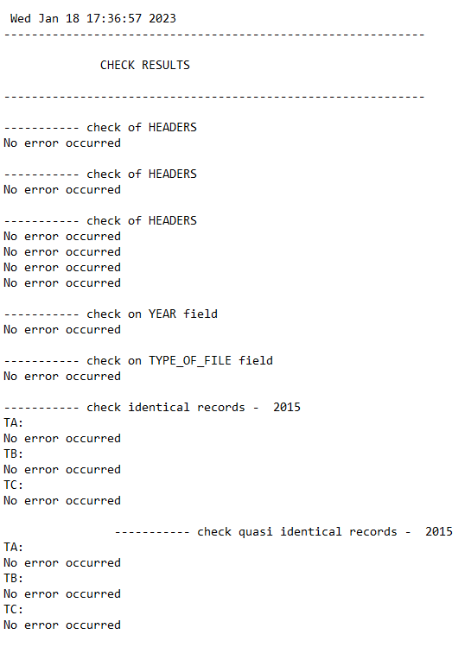
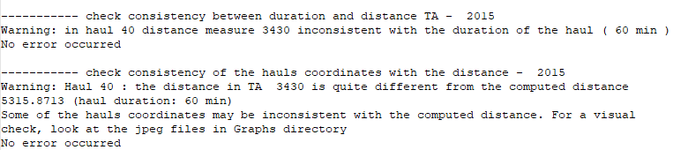
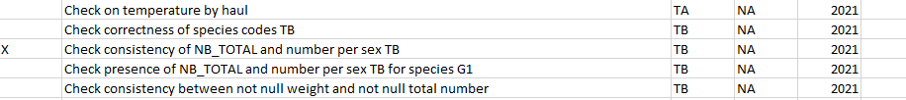
logfile
Warning
Error
logfile
Report of the errors

Slide 12
GENERAL CHECK
Check quasi-identical record
Two or more "quasi-identical records" occurred when all the fields are respectively equal, except:
(these specifc fields are allowed to be identical)
Warning
Warning
Keep attention!!!
TYPE_OF_FILE
AREA
GEAR
VESSEL
YEAR
RIGGING
DOORS
TYPE_OF_FILE
AREA
VESSEL
YEAR
Keep attention!!!
TA table
TB and TC table
Check of identical records
The function checks where there is one or more identical records in the selected type of table
Error
Check consistency of area
checks if TX files have the same area code
Error

Slide 13
GENERAL CHECK
Check of the dictionary of specific fields
The function checks whether the values contained in specific fields are consistent with the allowed values of the dictionaries.
Error
Check no empty fields
The function checks whether the values contained in specific fields are empty
Error
Check numeric range
The function checks whether values in a specific fields are consistent within the allowed range of values
Error
CHECK for TA
Check consistency between duration and time
Error
The function checks whether the durations reported in the haul data (TA) are consistent with the differences between HAULING_TIME and SHOOTING_TIME.
Check consistency between distance and duration
Error
The function checks whether the distances reported in the haul data (TA) are consistent with the hauls duration.

Slide 14
CHECK for TA
Check difference between start depth and end depth (not greater than 20%)
Check if that difference between start depth and end depth is not greater than 20%
Warning
Check consistency of stratum code
Checks whether start depth and end depth of each haul are in the same stratum.
Warning
verifies the correctness of the stratum code, following the stratification scheme table in the MEDITS protocol.
Warning
Check position
Visual check of the haul positions
Warning
Check if the coordinates are on the Sea
Warning
Check consistency of the hauls coordinates with the distance
The function checks wherther there are inconsistencies between the DISTANCE field values and the computed distance.
Warning

Slide 15
CHECK for TB
Check correctness of species codes
Function checking the correctness of species code and faunistic category according to TM reference list
Warning
Check consistency of TOTAL number and number per sex in TB
The function checks that the total number of individuals is consistent with the sum of the individuals per sex
Error
Check consistency of weight and number TB
Function that checks if number of individuals and total weight collected in the haul are consistent. The check is quantitative if there is information related to average individual weight. Alternatively the check is qualitative (through a plot).
Warning
Check of consistency in number per sex in G1 species
The function checks if total number, number of females, males and undetermined for G1 species are simultaneously null
Error

Slide 16
CHECK for TC
Check correctness of species codes
Function checking the correctness of species code and faunistic category according to TM reference list
Error
Check correctness of LENGTH_CLASSES_CODE
The function checks whether the LENGTH_CLASS_CODE by species are consistent with those reported in the TM list.
Error
Check consistency of length classes TC
The function checks whether the length classes by species are included in the range reported in the DataTargetSpecies table.
Warning
Check correctness of number per sex in TC
The function checks the consistency of the number of individuals by sex measured (NO_OF_INDIVIDUAL_OF_THE_ABOVE_SEX_MEASURED field in TC) with the sum of the individuals by sex, length class and maturity stage (NUMBER_OF_INDIVIDUALS_IN_THE_LENGTH_CLASS_AND_MATURITY_STAGE)
Error

Slide 17
CHECK for TC
Check sub-sampling
Function to warn the user about the presence of subsamples’ ratio < 0.1 of the total catch
Warning
Check of observed and estimated total weight in the haul
warning is given when difference between the sum of estimated individual weights (by haul, species and sub-samples) and the WEIGHT_OF_THE_SAMPLE_MEASURED is greater than 50% for at least one record. This check is based on the LW table contained in the package.
Warning
Check consistency of length distribution TC
The function verifies that in TC the length measures are reported with the correct precision
Error
Check correctness of species codes
Function checking the correctness of species code and taxonomic category according to TM reference list
Error

Slide 18
cross checks
Check presence in TB of TA hauls - Check presence in TA of TB hauls
The function checks:
presence of the TA hauls in the TB
presence of the TB hauls in the TA
Error
Check presence in TC of TB target species - Check presence in TB of TC species
The function checks whether
all the species present in TC are listed in TB
all the species in the TB are in the TC
Error
Warning
Check correctness of the number per sex in TB in case of sub-sampling in TC
Function checking if, in case of sub-sampling in TC, the Total number and the number per sex in TB is raised correctly
Error
Check on date by haul
Check if in TB, TC and TE the date by haul is the same of the one reported in TA
Error

Slide 19
The RoME v.0.1.39 package:
Open source code, publicly available on a GithHub repository
Can be used with 2 different functions: RoMEcc and RoMEBScc
Supports the fast identification of errors and inconsistencies in survey data
Allow to harmonize the MEDITS survey data quality checks among the Countries
Designed to facilitate a more systematic and well-defined schedule for quality checks prior the relevant data calls
Globally increases the data quality

